Slide 1


Slide 2

Care Seeker
Final Year Project

Slide 3
Introduction
Ali Bilal Ahmed
BC180404460

Slide 4

INTRODUCTION OF PROJECT Care Seekers
A web platform connecting Care Seekers with dedicated Support Workers for personalized assistance in Pakistan. Post jobs effortlessly, find compassionate caregivers, and prioritize personalized care services in the comfort of your home. Care Connect - Your bridge to reliable and tailored caregiving.

Slide 5
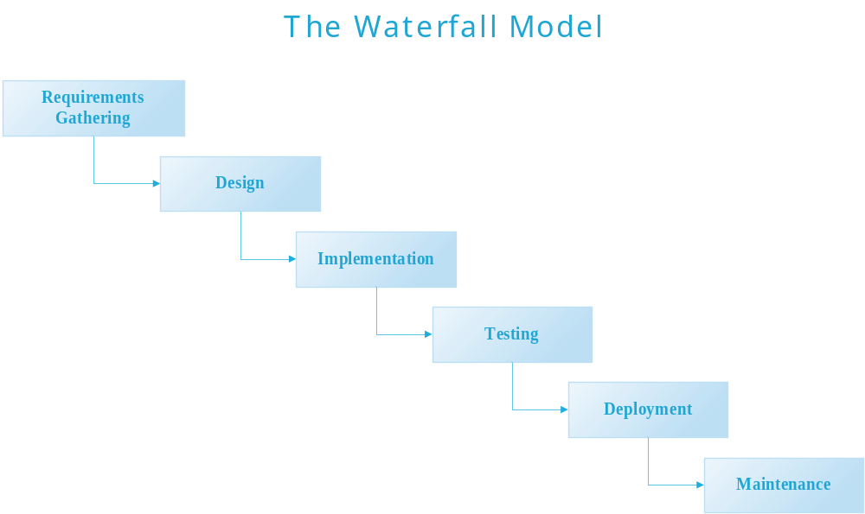

Slide 6
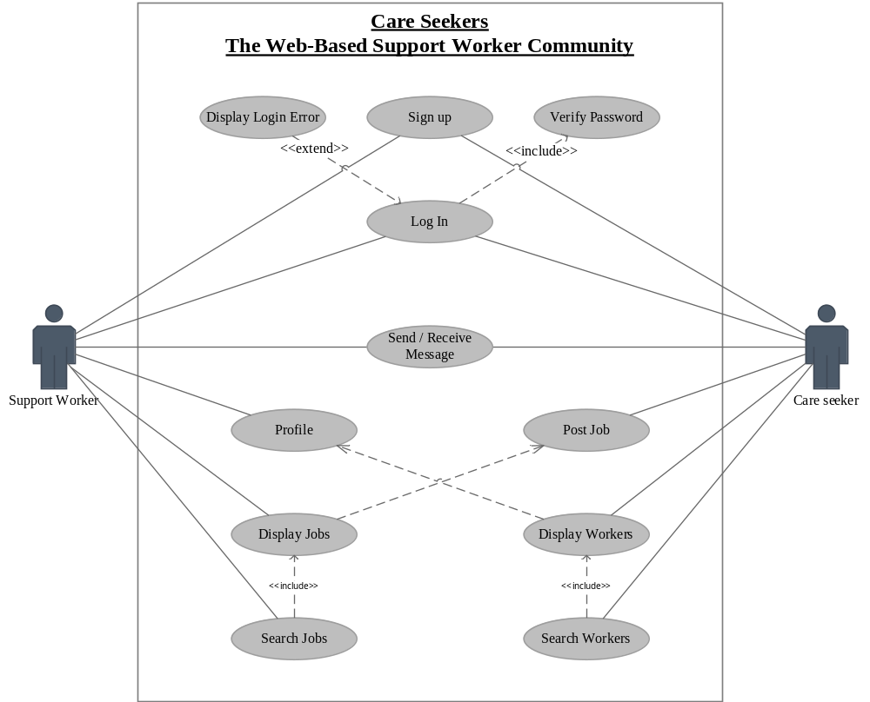

Slide 7
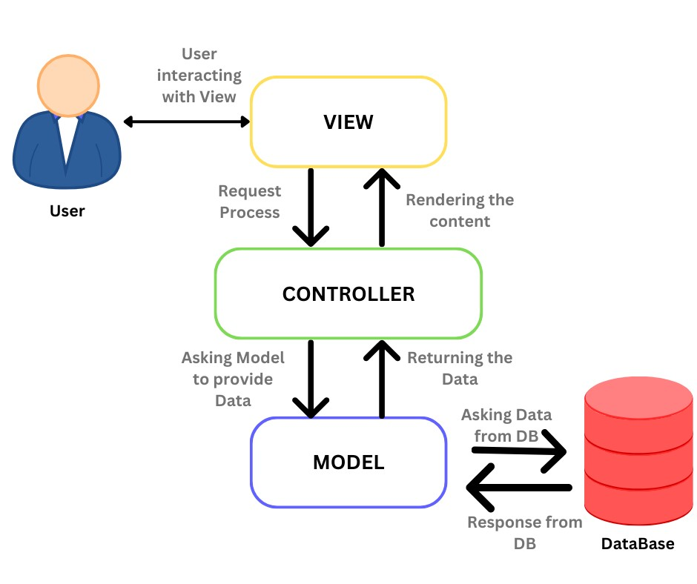
MVC Architectural

Slide 8
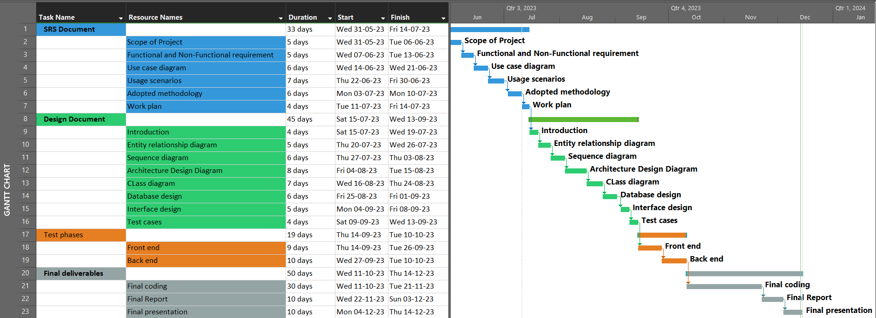
Project Schedule

Slide 9
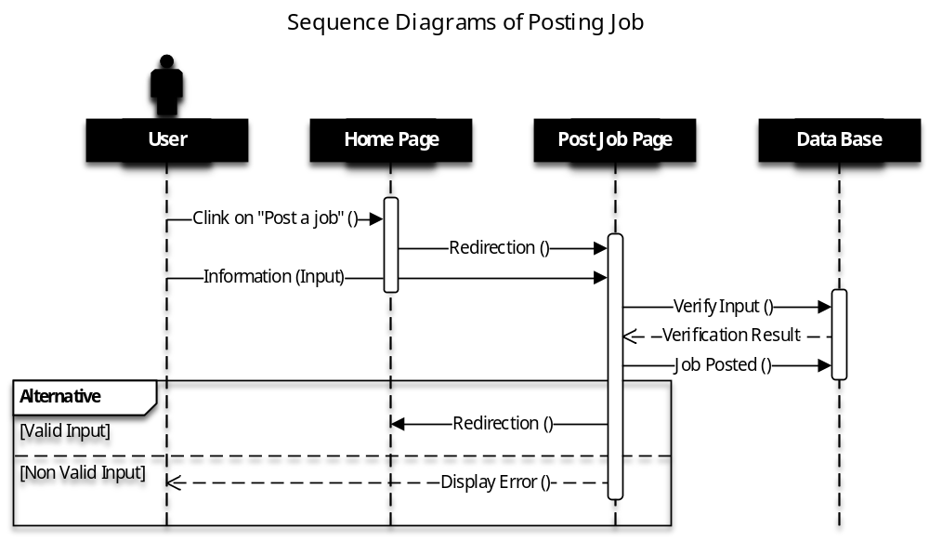
Sequence Diagrams

Slide 10
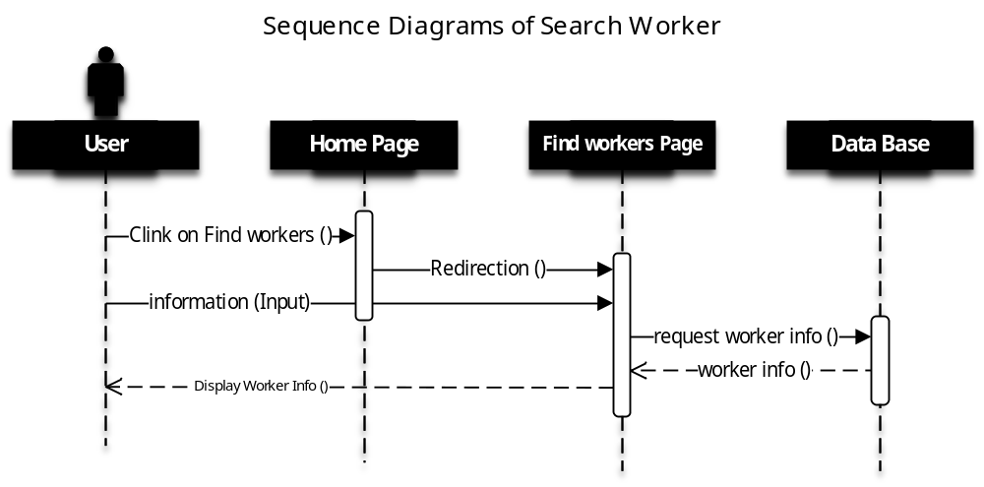
Search Worker

Slide 11
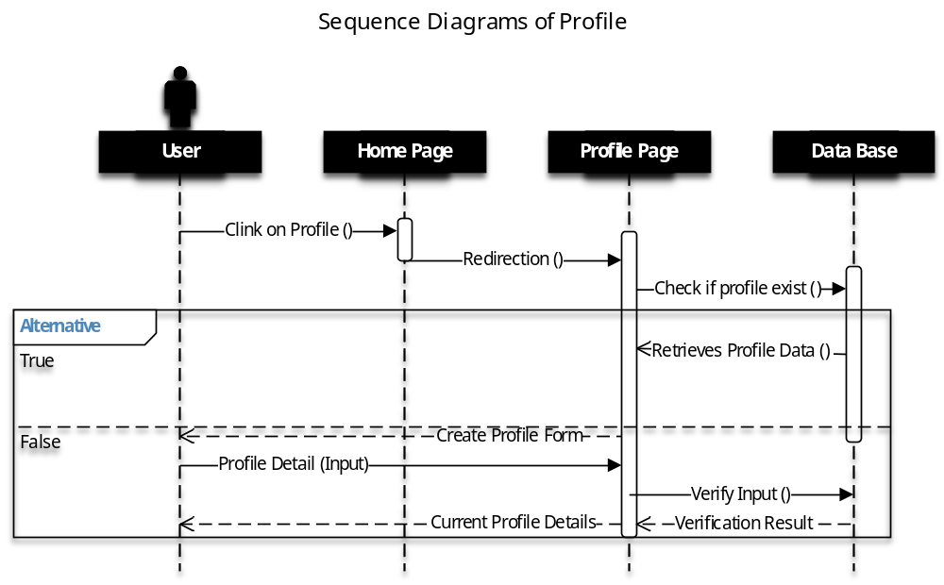
Support worker Profile

Slide 12
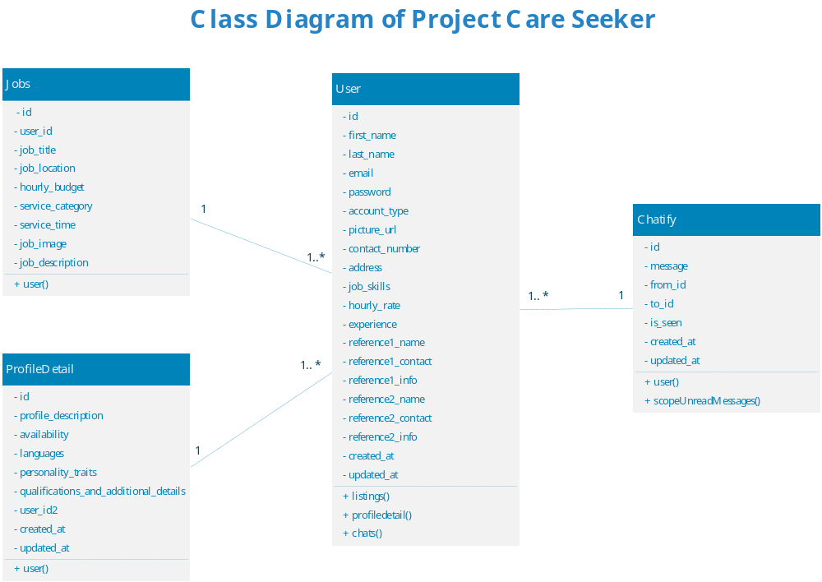
Logical Model/Class Diagram

Slide 13
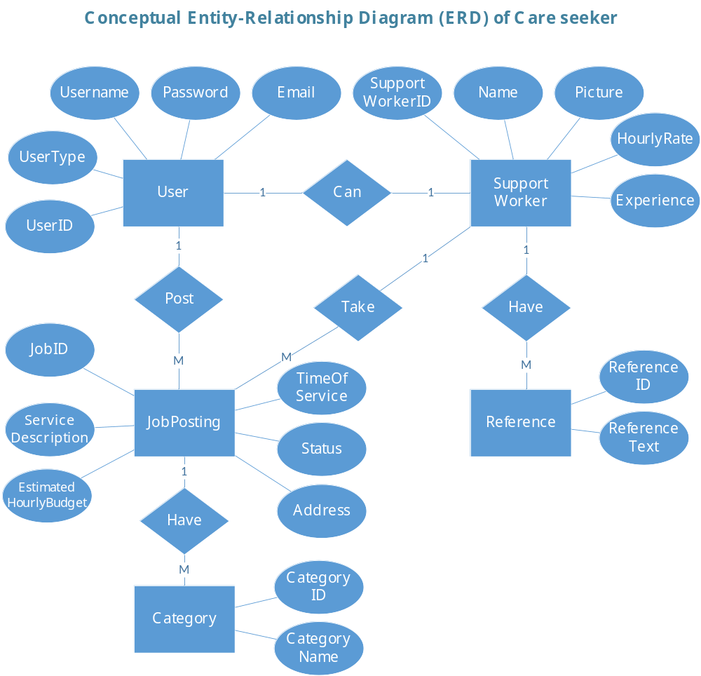
Entity-Relationship Diagram

Slide 14
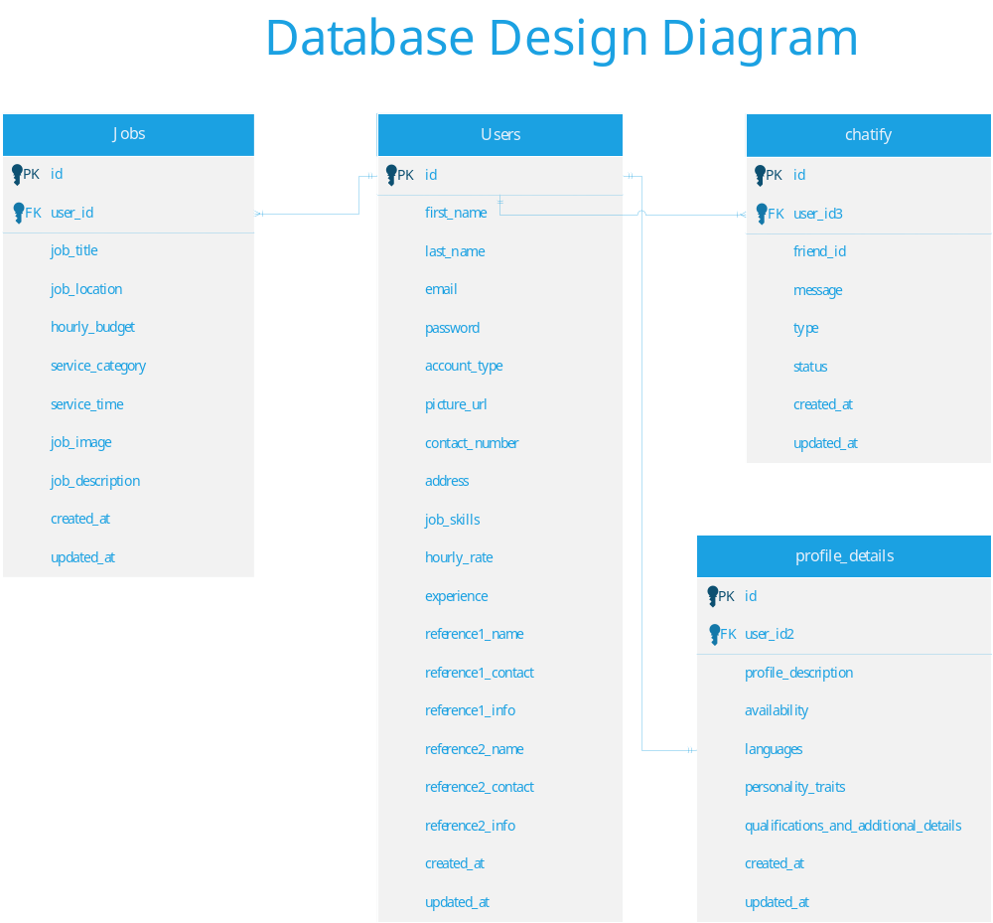
Database Diagram

Slide 15
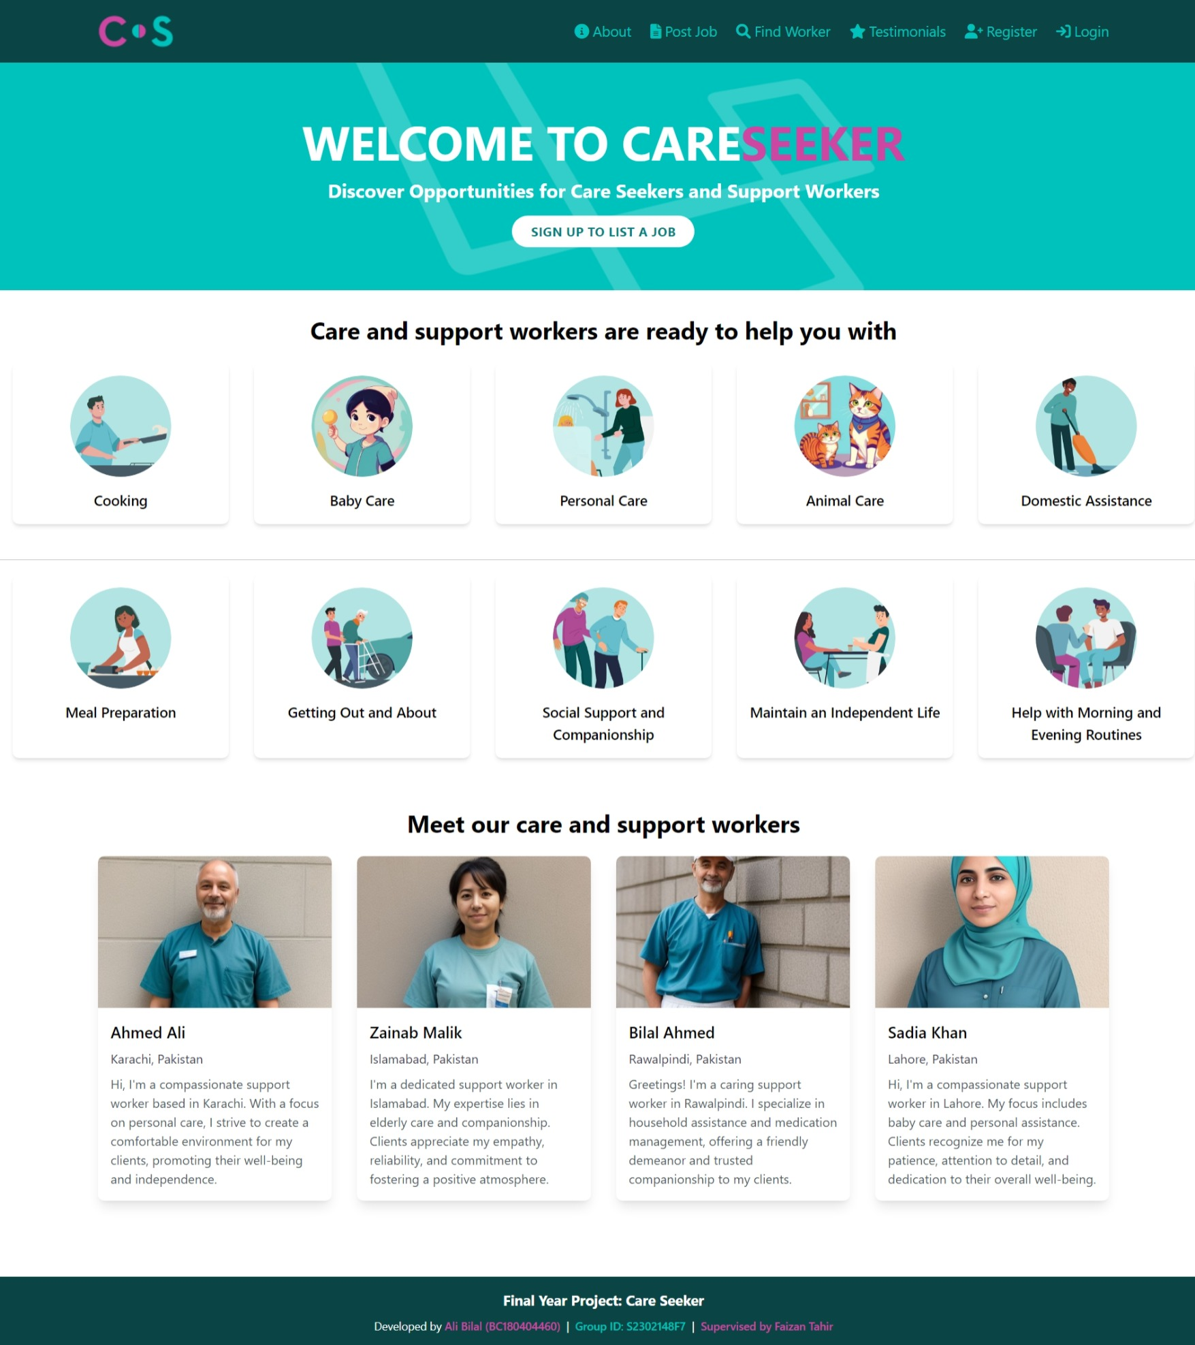
User Interfaces

Slide 16
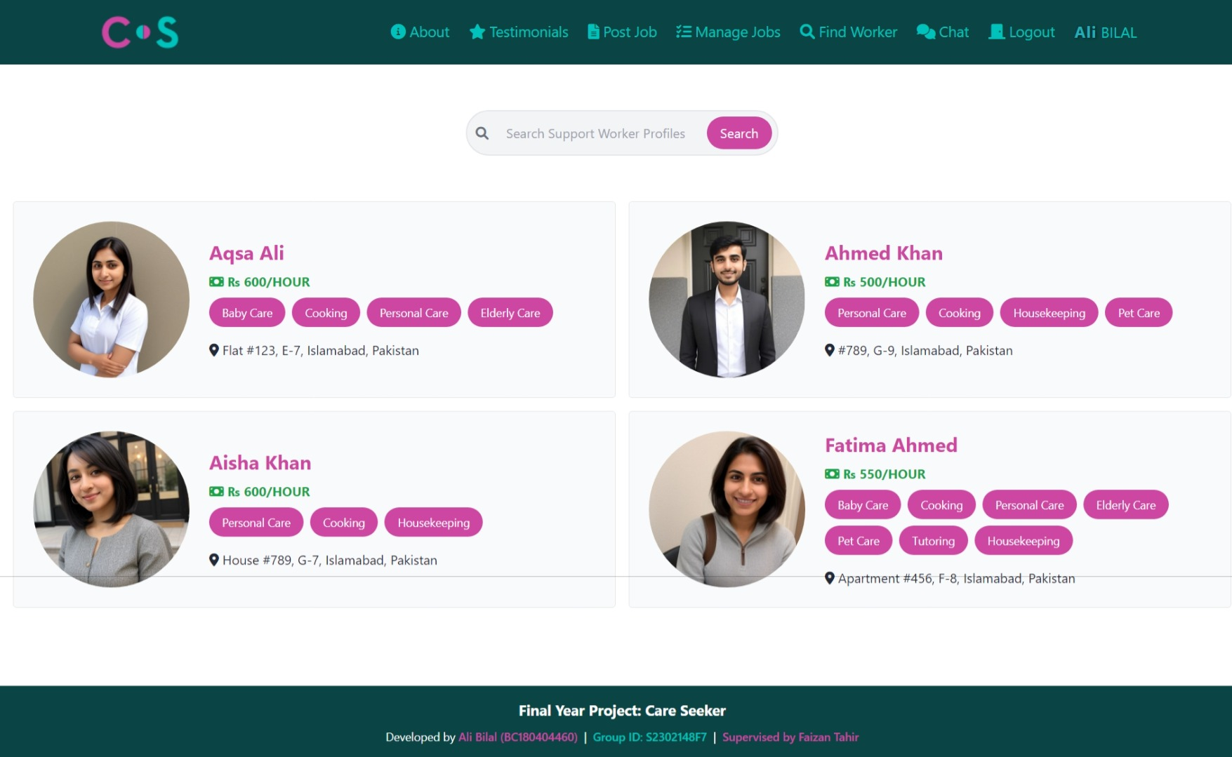
Support Worker List

Slide 17
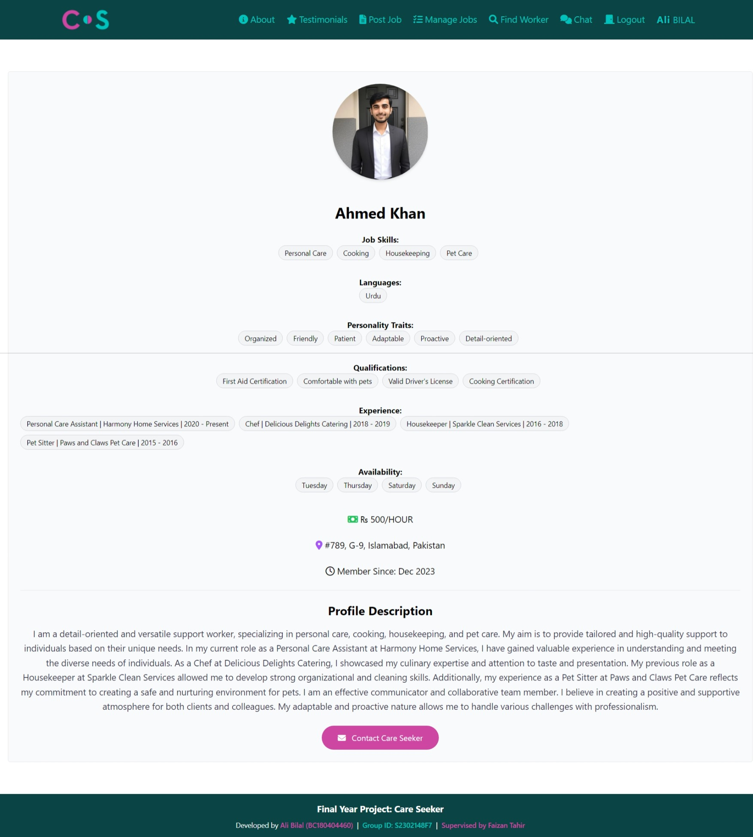
Support Worker Profile

Slide 18
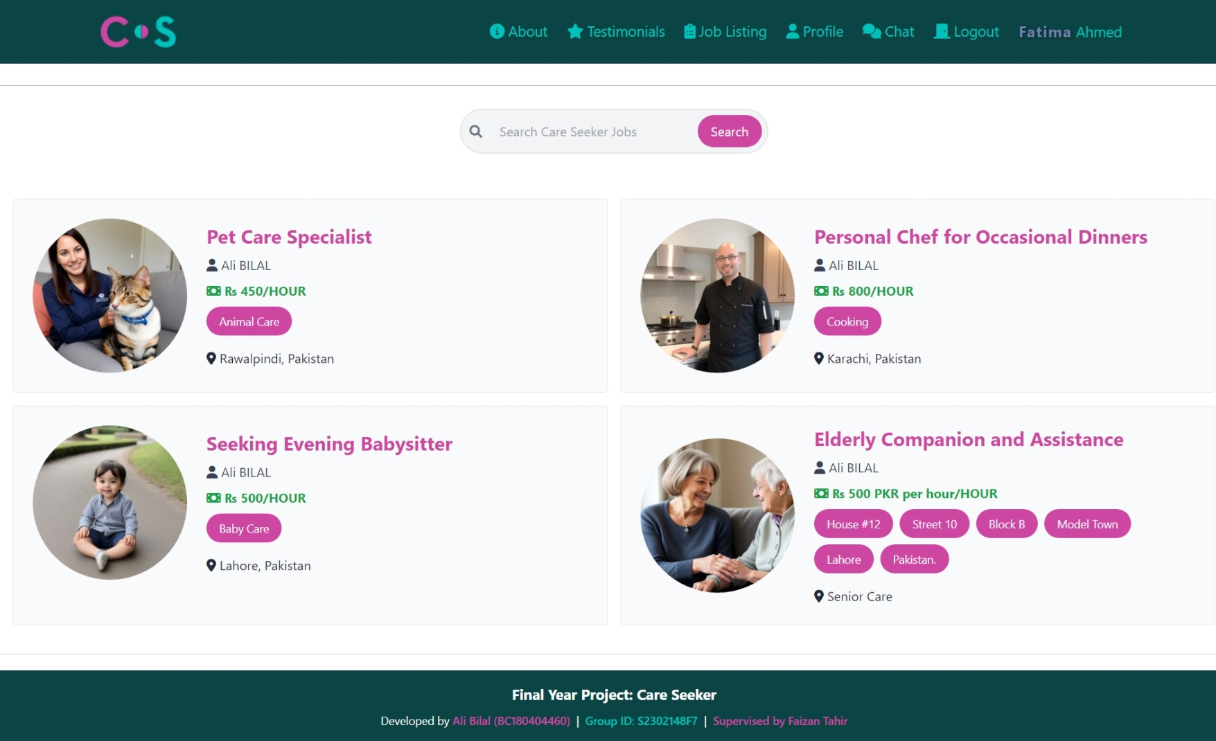
Job List

Slide 19
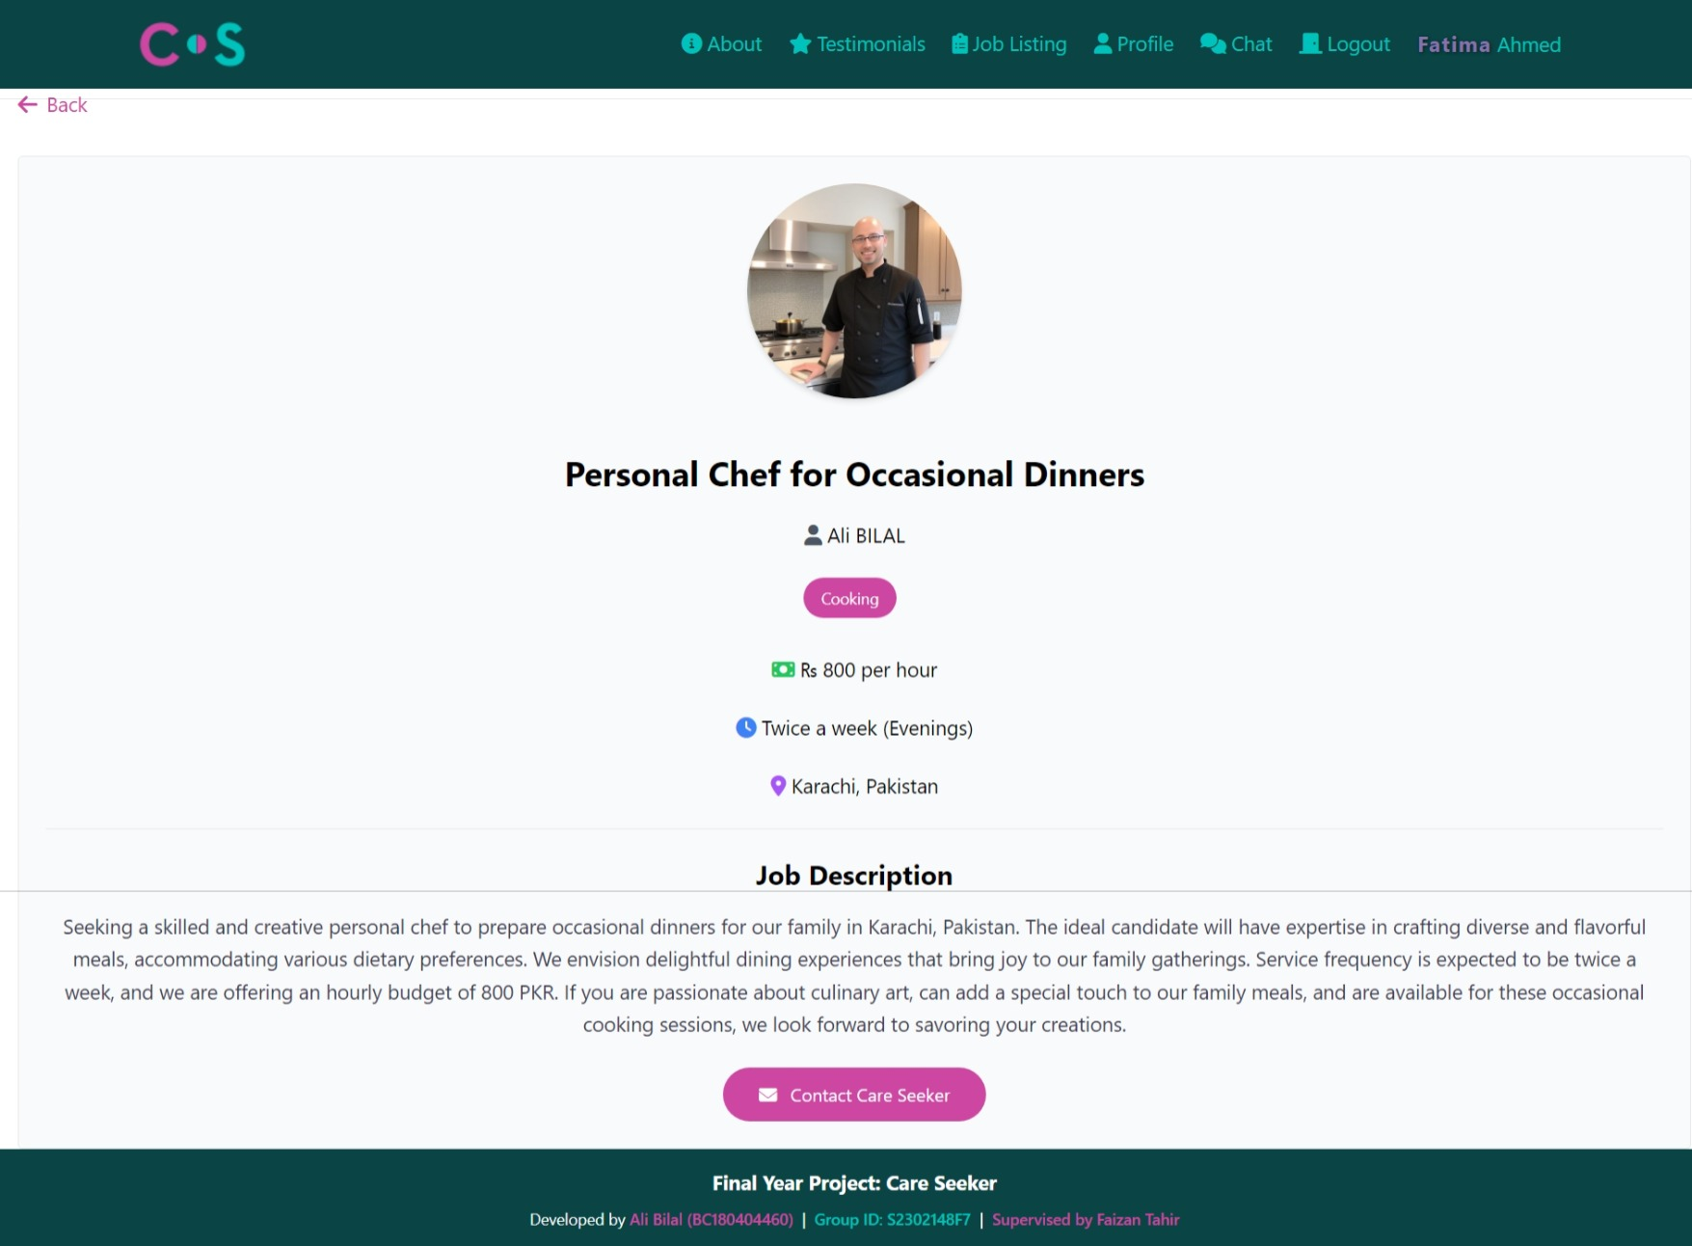
Job Page

Slide 20
Tools
1. Frontend Development:
HTML: Markup language for structuring content.
CSS: Styling language for designing the website.
JavaScript: Programming language for interactive features.
2. Backend Development:
Laravel: Full-stack PHP framework for robust backend development.
3. Chat Feature:
Chatify: Chat package for implementing messaging functionality.
4. Database:
MySQL: Relational database management system for data storage.
5. Design and UI/UX:
Tailwind CSS: Utility-first CSS framework for streamlined styling.
6. JavaScript Framework:
Alpine.js: Lightweight JavaScript framework for dynamic interactivity.
7. Web Development Tools:
Visual Studio Code: Code editor for development.

